Slide 1
December General Meeting
Wednesday, December 14th, 2022

Slide 2
Follow Our Instagram!
@phuhs_hosa

Slide 3
HOSA Competitor Remind
@comphosa22

Slide 4
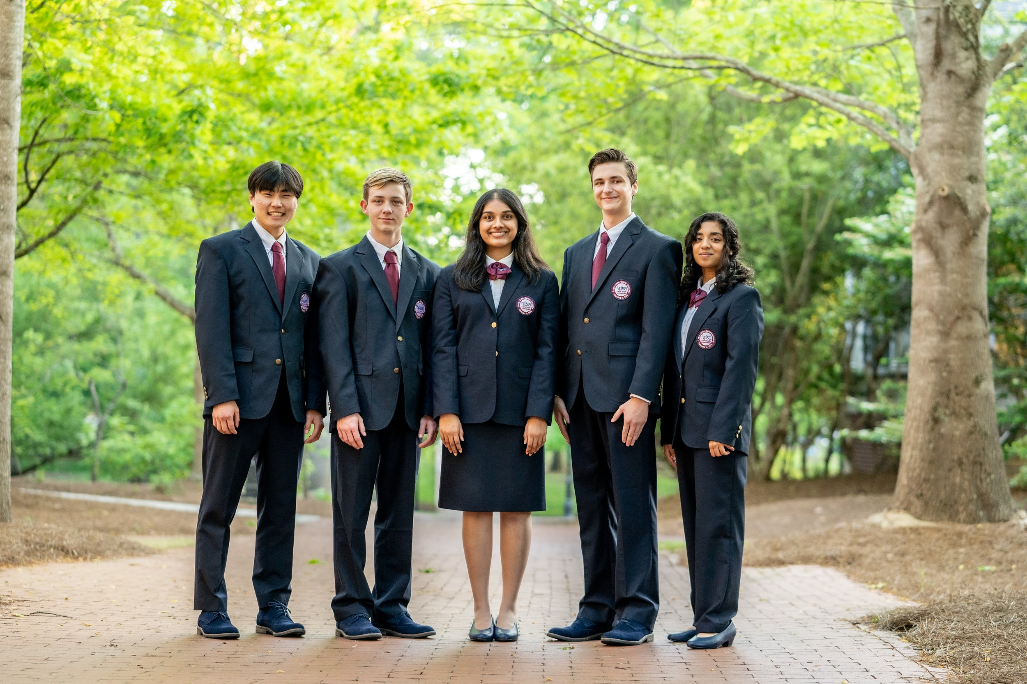
HOSA Uniform
White Collared Shirt
Navy Blue or Black Blazer
Navy Blue or Black Dress Pants or Knee-Length Skirt
Boys: Maroon or Navy Blue Tie (Solid color)

Slide 5
Mark Your Calendars!
Upcoming Dates:
Before Winter Break: Testing Results will be released and students will be notified if they are moving on to compete at regionals.
January 11th: The Final Competition Meeting
January 21st: Regional Competition!!

Slide 6
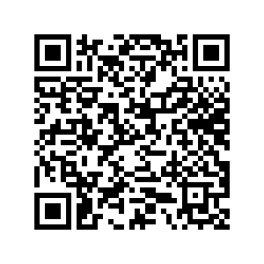
HOSA Uniform Submissions
If you haven’t yet submitted a photo of your uniform, please do so by our next advisor meeting. (January 11th)

Slide 7
Thank you to everyone who donated to our Kimberly Home Drive!
We will be having a Celebration right after this meeting!

Slide 8
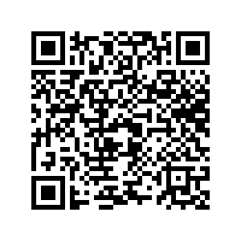
Attendance

